Slide 1
Title: Restaurant Rating Prediction using Machine Learning
Presented by: Jagdish Kaur (72510781)
Jasmeen Kaur (72510182) Course: Machine Learning

Slide 2
Introduction
Restaurant ratings influence customer decisions
Online platforms collect large amounts of review data
Manual analysis is difficult
Machine Learning helps automate prediction

Slide 3
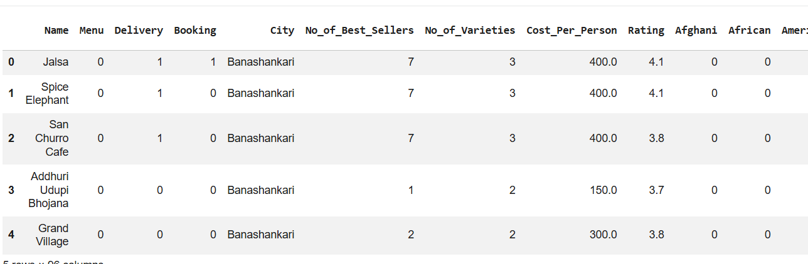
Problem Statement
Predict restaurant ratings based on features Features include:
Booking
Cuisine
Price range
Online delivery availability
Goal: Build an accurate prediction model

Slide 4
Objectives
Analyze restaurant dataset
Perform data preprocessing
Apply Machine Learning algorithms
Evaluate model performance
Predict ratings for new restaurants

Slide 5
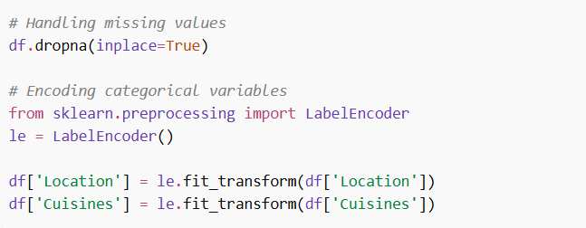
Data Preprocessing
Handling missing values
Encoding categorical variables
Feature selection
Removing duplicates
Data normalization

Slide 6
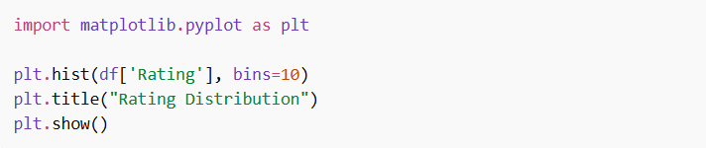
Exploratory Data Analysis (EDA)
Distribution of ratings
Most popular cuisines
Impact of cost on rating
Location-wise rating trends
Visualization tools:
Matplotlib
Seaborn

Slide 7
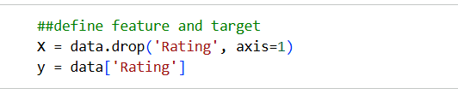
Feature Engineering and selection
Convert text data to numerical form
Create new features: Cost per person
Cuisine categories
Label encoding / One-hot encoding

Slide 8
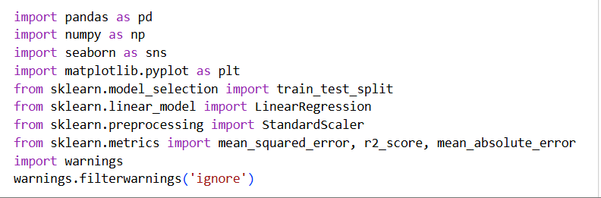
Machine Learning Algorithms Used
Linear Regression
Libraries used -:

Slide 9
Model Training
Split dataset: Training set (80%)
Testing set (20%)
Train models on training data
Tune hyperparameters

Slide 10
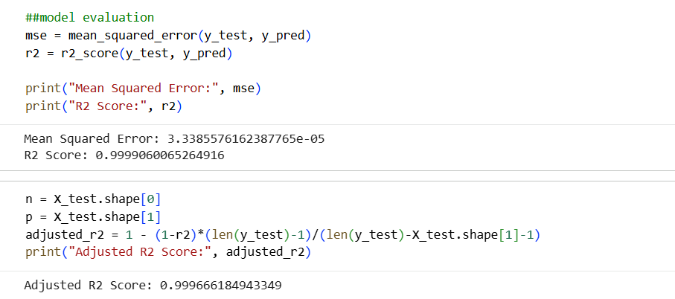
Model Evaluation
Evaluation metrics: Mean Absolute Error (MAE)
Mean Squared Error (MSE)
R² Score

Slide 11
Results
Best performing model: (e.g., Linear Regression)
Achieved accuracy: 99%
Observations:
Cost and votes strongly affect rating
Location also plays a role

Slide 12
Applications
Helps customers choose restaurants
Helps businesses improve services
Useful for food delivery platforms

Slide 13
Conclusion
ML can effectively predict restaurant ratings
Data preprocessing is crucial
Linear Regression performs well
Project demonstrates real-world ML application

Slide 14
Thank you

